Slide 1
Organizing for Power
NOW
Check out this plan on the web: afge.org/NOW
Notes:
Intro yourself and the topics today
Organizing plan to build our collective power
An update on where we stand today with the new EOs President Biden signed
Get feedback from local/council leaders on the plan and answer any questions they may have

Slide 2
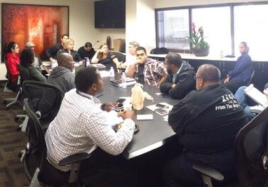
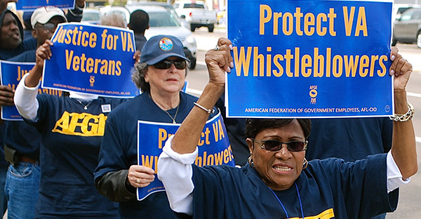
Module 2: Negotiation Skills
Notes:
Suggested Language:
Hello my name is___ I am the ____ at___.
Welcome to AFGE’s Introduction to Collective Bargaining II class on Negotiation Skills. This training has been designed to provide you with the skills and knowledge to negotiate effectively to improve the conditions of employment for the federal employees you represent.
This training will be a hands-on workshop that will use realistic scenarios and cases studies for you to engage in and demonstrate effective negotiation skills and techniques.

Slide 3
Module 2 Overview
Traditional vs. Interest-Based Bargaining (“IBB”)
The IBB process and steps
IBB techniques, tactics, and strategies
3

Slide 4
Poll Question
What do you believe to be the most challenging aspect of bargaining ?
Raise your hand to be unmuted

Slide 5
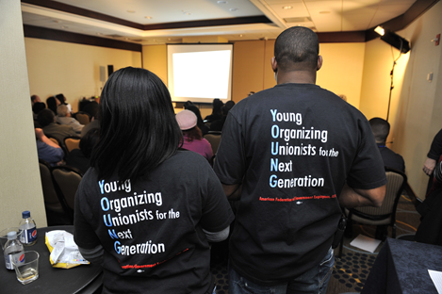
Negotiation Methods
Traditional Bargaining

Slide 6
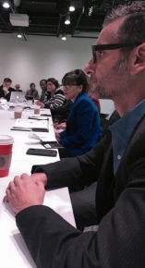
Stages of Traditional Bargaining
Preliminary Stage
Establish negotiator identity
Establish tone for negotiations
Information Stage (Initial proposal/offer)
Questioning
Listening
Offers
Control Response

Slide 7
Stages of Traditional Bargaining, (cont.)
Competitive/Distributive Stage
(Claiming value of position/proposal)
Value claiming
Concessions
Deal with adversity
Power bargaining
Closing Stage (Finalizing options of what can work)
Less concessions
Increased need for reciprocation
Patience and calculated silence

Slide 8
Stages of Traditional Bargaining, (cont.)
Cooperative/Integrative Stage (Maximizing the value of agreement)
Advancing interests of all Parties
Direct discussions
Preserve credibility
Explore all alternatives prior to Final Agreement
Leave opponent thinking they got a good deal
Get it in Writing

Slide 9
Effective Negotiation Techniques
Preparation, preparation, preparation
Establish rapport
Attitudinal bargaining: reward cooperation, confront adversarial approach
Control your response
Find and use leverage

Slide 10
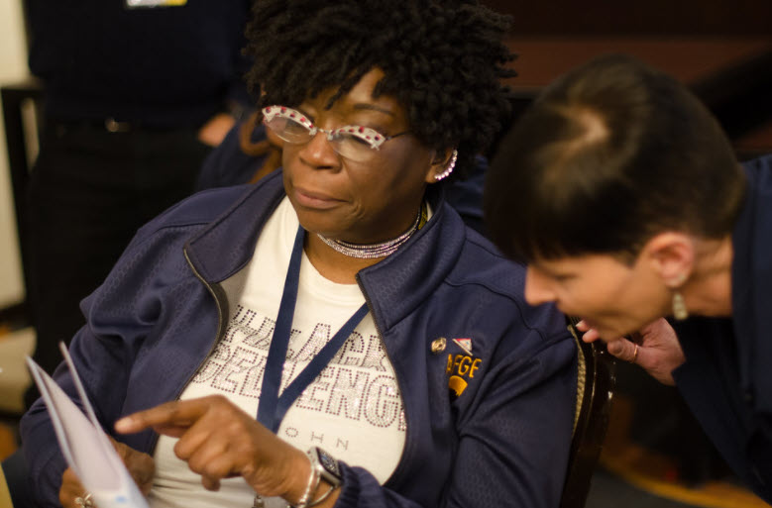
Negotiation Methods
Interest-based Bargaining

Slide 11
Poll Question
Have you and your Agency discussed Biden EO 14003?
Type in the chat
A: Yes
B: No

Slide 12
What is Interest-Based Bargaining?
Interest Based Bargaining (IBB) is an approach to collective bargaining that is designed to help parties express, understand and build agreements around shared interests, concerns or desires.
Notes:
Key differences between traditional bargaining which is focused on positions and IBB which is focused on interests.
position: one party’s proposed solution to an issue; the how
A position statement: focuses on a particular solution, makes a demand, and sets up confrontation before the problem has been clearly defined.
interest: one party’s concern, need, or desire behind an issue; why the issue is being raised
An interest statement: focuses on the problem, articulates one of a range of needs and, establishes a climate and a common language for discussion so that the real issue or problem can be understood, discussed, and negotiated.
IBB utilizes problem solving tools as a way to avoid “positional” conflicts (when one party gets entrenched in a particular solution to a problem) and instead helps parties work jointly to come to mutual decisions and build consensus.

Slide 13
What is Interest-Based Bargaining? (cont.)
Interest based bargaining is a bargaining method aimed at “expanding the pie,” meaning each party can get a bigger slice without having one side gain at the expense of the other.
Joint problem solving is intended to provide bigger slices for everybody.

Slide 14
What is Interest-Based Bargaining? (cont.)
IBB is also referred to as:
Win-Win Bargaining
Mutual Gains Bargaining
Principled or Interest-Based Negotiation
Interest-Based Problem Solving
Best Practice or Integrative Bargaining

Slide 15
What is Interest-Based Bargaining? (cont.)
The Difference Between Adversarial Bargaining and IBB
In traditional “adversarial” bargaining, parties dig into their positions and exchange demands.
In IBB, the parties focus on understanding the problem and identifying the interests that underlie each side’s issues needs and wants.

Slide 16
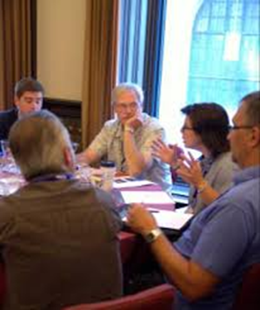
What is Interest-Based Bargaining? (cont.)
IBB is a process that enables traditional negotiators to become “joint problem-solvers.”
IBB assumes that mutual gain is possible and that solutions which satisfy mutual interests are more durable.
The parties should help each other achieve a positive result.

Slide 17
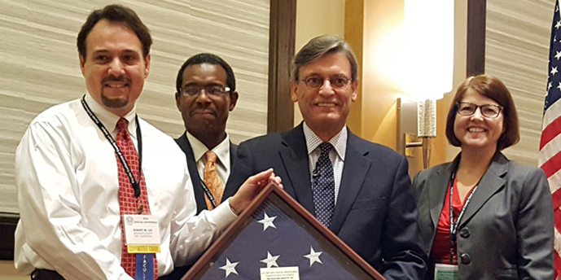
What is Interest-Based Bargaining? (cont.)
IBB has 3 distinct goals:
to reach a mutually desired and durable result
to reach agreement efficiently and fairly
to keep the relationship intact

Slide 18
Six Principles of Interest-Based Bargaining
1) Sharing relevant information is critical for effective solutions.
2) Focus on issues, not personalities.
3) Focus on the present and future, not the past.
4) Focus on the interests underlying the issues.
5) Focus on mutual interests and helping to satisfy the other party’s interests as well as your own.
6) Options developed to satisfy those interests should be evaluated by objective criteria, rather than power or leverage.

Slide 19
What is required to be successful?
Evidence of labor-management cooperation during the past contract term.
Sufficient time remaining prior to contract expiration to complete the sequence of decision-making about IBB,
training and application
of the process.
Willingness of the parties to fully share relevant bargaining information.
Willingness to forgo power as the sole method of "winning.“
Understanding and acceptance of the process by all participants and their constituents.

Slide 20
IBB Getting Started
Training with IBB experienced facilitator
Joint meeting of the participants and mediators to reach agreement on ground rules and protocols
Bargaining begins with discussion of issues and interests

Slide 21
IBB Training
IBB begins with formal training by a facilitator. The participants must accept the principles and assumptions that underlie the process and follow the steps and use the techniques during negotiations to be successful.

Slide 22
IBB Joint Start-up Meeting
With a decision to proceed, mediators facilitate a joint meeting of the participants to reach agreement on ground rules and protocols under which the bargaining will be conducted, an exchange of the issues to be negotiated, and steps for a transition to traditional bargaining if the IBB process breaks down.

Slide 23
IBB: The Process
Problem solving is about resolving underlying interests.
Interests are your needs, concerns, or desires behind a particular problem.
The “why” behind the problem.
Interests drive any negotiated outcome if a problem is to be really resolved.
“I WANT, BECAUSE…
Notes:
IDENTIFY YOUR INTERESTS (Not Positions)
Positions are the concrete things you want – but behind your positions are your INTERESTS.
Your INTERESTS are the intangible motivations that lead you to a position. They are your needs, desires, concerns and fears.
You discover your INTERESTS by asking the question, Why? Why do I want that?
Focusing on INTERESTS, not positions, leads you to choices or options that could never be considered if you focused on your concrete positions.
Options are not rigid objectives; they are potential solutions that would satisfy most, if not all, interests that people have if they want to solve a problem.

Slide 24
IBB: Interest vs. Positions
Position: one party’s proposed solution to an issue; the how.
A position statement:
focuses on a particular solution,
makes a demand, and
sets up confrontation before the problem has been clearly defined.

Slide 25
IBB: Interest vs. Positions (cont.)
Converting positions to interests:
If a demand, solution, proposal, or position appears on your interest list, convert it to an interest by asking what problem it is trying to solve or what concern it is intended to address.

Slide 26
IBB Process: Steps In Interest Based Bargaining
Identify Issue (Issue Statement)
Parties identify topic or problems
Identify Interests
Identify each sides needs/wants and determine which are mutual
Identify separate and/or conflicting interests
Develop Options for solutions that involves interests
Utilize joint brainstorming
Refine list: eliminate duplicates, consolidate similar options
Evaluate Options
Feasible – legal, affordable, workable, understandable?
Beneficial – satisfy important interests, better then what you have today?
Acceptable – fair and equitable, pass Agency head review?
Agree on Solutions
Consensus – all members agree or “A decision everyone can live with”
Write up the agreement
Notes:
STEPS IN INTEREST BASED BARGAINING
1) Issue Statement
The Parties should attempt to identify the topic or problem being addressed (it is important to distinguish the issue from the positions or proposals)
2) Identifying Interests
The Parties should attempt to parse out what each sides needs/desires are, and which are mutual
Interest based bargaining does not allow parties to adopt “positions”
Identify which interests are conflicting, which are separate, and which are separate but not conflicting
3) Options – develop options for how to deal with the problem that takes into account the interests of the parties
Utilize joint brainstorming
Refine the list of brainstorming options, eliminating duplicative ideas and consolidating similar ideas
4) Evaluate the options to make sure they are:
Feasible – legal, affordable, workable, understandable
Beneficial – satisfy important interests, better then what you have today?
Acceptable – fair and equitable, pass Agency head review
5) Solutions
Consensus – all members agree or are willing to accept the solution “A decision everyone can live with”
Write up the agreement

Slide 27
Techniques, Tactics & Strategies
Interest-based Bargaining

Slide 28
IBB: Effective Negotiation Techniques
Focus on issues – not personalities or the past
Describe the problem, don’t accuse or assign motivation
Focus on interests – not positions
Understand interests – don’t judge them
Defer evaluation during the option-generating stage
Evaluate options with standards

Slide 29
IBB: Effective Negotiation Techniques (cont.)
Share Information
Respect the role and responsibility of others – listen
Be open to reasoned argument
If you dissent – explain why and propose alternate solutions or suggest how to modify existing solutions
Be willing to change your mind
Sustain the relationship and process

Slide 30
IBB: Building Consensus
Listen actively
Encourage others to participate
Share information
Don’t change your mind to get along
Yield to reason not pressure
Listen to all ideas

Slide 31
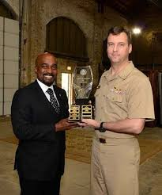
IBB: Building Consensus
Don’t bargain
Work collaboratively
Combine ideas creatively
Don’t argue for an idea because it’s yours
Look for mutual gains approaches

Slide 32
Poll Question
What are your thoughts on IBB ?
Do you believe the Biden EO 14003 presents opportunity for bargaining gains ?
Raise your hand to be unmuted

